Slide 1
Avoiding death by PowerPoint (& emails)
Lyn Howard AdvFEDIP
Clinical Network Manager
North West Coast Maternity Clinical Network
Notes:
I’m going to talk to you about how R can remove some of the tedium from repetitive tasks like compiling Powerpoint slides or sending emails.

Slide 2
XXXXXXXXXX
SUMMARY: XXXXXXXXXXXXXXX
Update circles to reflect the latest RAG, which are available in the summary tab, under the heading Programme Status and Factors.
Click on the Programme Profile and then click on the most recently Monthly Risk Reporting (should have been published before submission date) and copy and paste narrative under “What are the risks that could impact delivery of your initiative’s objectives, outcomes or benefits - as specified in the business case?”. If nothing is written here, please click on the risk tab and copy and paste a summary risk titles.
Issues should be copied and pasted from the Issue tab.
DELIVERY RAGS
CONFIDENCE | AGAINST PLAN |  | AGAINST BUDGET | AGAINST RESOURCE
What supporting justification is provided for the assigned delivery confidence?
What achievements and progress have occurred in the reporting period?
Workforce Data |  | Financial Spend Data | Financial Spend Data
 |  |  | TD Revenue Spend at Month 08 was £17,832,001 •YTD Capital (drawdown) at Month 08 £4,205,000
What are the current issues/risks impacting the programme?
ISSUES: ~~~~~~~~~~~~~~~~~~~~~~~~~~~~~~~~~~~~~~~~~~~~~~~~~~. | RISKS: ……………….. ………………….. ……………….. ~~~~~~~~~~~~~~~~~~~~~~~~~. !!!!!!!!!!!!!.
How does the programme plan to resolve these issues/risks?
*************. &&&&&&&&&&&&&&& | ~~~~~~~~~~~~~~~~~~~~~~ ……………………………………………… >>>>>>>>>>>>>>>>>>>>>>>>>. <<<<<<<<<<<<<<<<<<<<<<<<<<<<<<<<<<<<<<<<<<<<<<<<<<<. …………………………………………………………………………………………………………………………………………………………..
Click on the Programme Profile and then Programme Status and Factors and then Overall Delivery Confidence and copy and paste the justification
Click on the Programme Profile and then click on the most recently Monthly Recent Narrative (should have been published before submission date) and copy and paste narrative under “What are the main RECENT ACHIEVEMENTS that you would like to highlight to corporate leadership”
Click on the Risk and Issue Tab and click on each relevant risk or issue, copy and pasting the mitigating actions detailed.
If the totality of mitigating actions goes beyond the space, seek to summarise and ask teams to sense check when they review the draft slides.
Workforce Data is accessible on the main Programme Profile page under “Workforce Overview”. Copy and paste with headings and sense check against Workforce Data held by PMO Team.
Notes:
When I joined the Digital Enablement Portfolio Office, this is the template they were using to compile reports.

Slide 3
XXXXXXXXXX
Update circles to reflect the latest RAG, which are available in the summary tab, under the heading Programme Status and Factors.
SUMMARY: XXXXXXXXXXXXXXX
Click on the Programme Profile and then click on the most recently Monthly Risk Reporting (should have been published before submission date) and copy and paste narrative under “What are the risks that could impact delivery of your initiative’s objectives, outcomes or benefits - as specified in the business case?”. If nothing is written here, please click on the risk tab and copy and paste a summary risk titles.
Issues should be copied and pasted from the Issue tab.
DELIVERY RAGS
CONFIDENCE | AGAINST PLAN |  | AGAINST BUDGET | AGAINST RESOURCE
What supporting justification is provided for the assigned delivery confidence?
What achievements and progress have occurred in the reporting period?
Workforce Data |  | Financial Spend Data | Financial Spend Data
 |  |  | TD Revenue Spend at Month 08 was £17,832,001 •YTD Capital (drawdown) at Month 08 £4,205,000
What are the current issues/risks impacting the programme?
ISSUES: ~~~~~~~~~~~~~~~~~~~~~~~~~~~~~~~~~~~~~~~~~~~~~~~~~~. | RISKS: ……………….. ………………….. ……………….. ~~~~~~~~~~~~~~~~~~~~~~~~~. !!!!!!!!!!!!!.
How does the programme plan to resolve these issues/risks?
*************. &&&&&&&&&&&&&&& | ~~~~~~~~~~~~~~~~~~~~~~ ……………………………………………… >>>>>>>>>>>>>>>>>>>>>>>>>. <<<<<<<<<<<<<<<<<<<<<<<<<<<<<<<<<<<<<<<<<<<<<<<<<<<. …………………………………………………………………………………………………………………………………………………………..
Click on the Programme Profile and then Programme Status and Factors and then Overall Delivery Confidence and copy and paste the justification
Click on the Programme Profile and then click on the most recently Monthly Recent Narrative (should have been published before submission date) and copy and paste narrative under “What are the main RECENT ACHIEVEMENTS that you would like to highlight to corporate leadership”
Click on the Risk and Issue Tab and click on each relevant risk or issue, copy and pasting the mitigating actions detailed.
If the totality of mitigating actions goes beyond the space, seek to summarise and ask teams to sense check when they review the draft slides.
Workforce Data is accessible on the main Programme Profile page under “Workforce Overview”. Copy and paste with headings and sense check against Workforce Data held by PMO Team.
Notes:
The template came with instructions of all the different areas of the CRM that needed to be accessed to get the content to go in the report.

Slide 4
XXXXXXXXXX
Update circles to reflect the latest RAG, which are available in the summary tab, under the heading Programme Status and Factors.
SUMMARY: XXXXXXXXXXXXXXX
Click on the Programme Profile and then click on the most recently Monthly Risk Reporting (should have been published before submission date) and copy and paste narrative under “What are the risks that could impact delivery of your initiative’s objectives, outcomes or benefits - as specified in the business case?”. If nothing is written here, please click on the risk tab and copy and paste a summary risk titles.
Issues should be copied and pasted from the Issue tab.
DELIVERY RAGS
CONFIDENCE | AGAINST PLAN |  | AGAINST BUDGET | AGAINST RESOURCE
What supporting justification is provided for the assigned delivery confidence?
What achievements and progress have occurred in the reporting period?
Workforce Data |  | Financial Spend Data | Financial Spend Data
 |  |  | TD Revenue Spend at Month 08 was £17,832,001 •YTD Capital (drawdown) at Month 08 £4,205,000
What are the current issues/risks impacting the programme?
ISSUES: ~~~~~~~~~~~~~~~~~~~~~~~~~~~~~~~~~~~~~~~~~~~~~~~~~~. | RISKS: ……………….. ………………….. ……………….. ~~~~~~~~~~~~~~~~~~~~~~~~~. !!!!!!!!!!!!!.
How does the programme plan to resolve these issues/risks?
*************. &&&&&&&&&&&&&&& | ~~~~~~~~~~~~~~~~~~~~~~ ……………………………………………… >>>>>>>>>>>>>>>>>>>>>>>>>. <<<<<<<<<<<<<<<<<<<<<<<<<<<<<<<<<<<<<<<<<<<<<<<<<<<. …………………………………………………………………………………………………………………………………………………………..
Click on the Programme Profile and then Programme Status and Factors and then Overall Delivery Confidence and copy and paste the justification
Click on the Programme Profile and then click on the most recently Monthly Recent Narrative (should have been published before submission date) and copy and paste narrative under “What are the main RECENT ACHIEVEMENTS that you would like to highlight to corporate leadership”
Click on the Risk and Issue Tab and click on each relevant risk or issue, copy and pasting the mitigating actions detailed.
If the totality of mitigating actions goes beyond the space, seek to summarise and ask teams to sense check when they review the draft slides.
Workforce Data is accessible on the main Programme Profile page under “Workforce Overview”. Copy and paste with headings and sense check against Workforce Data held by PMO Team.
Notes:
The process would take someone a couple of days of manually clicking into different areas…

Slide 5
XXXXXXXXXX
Update circles to reflect the latest RAG, which are available in the summary tab, under the heading Programme Status and Factors.
SUMMARY: XXXXXXXXXXXXXXX
Click on the Programme Profile and then click on the most recently Monthly Risk Reporting (should have been published before submission date) and copy and paste narrative under “What are the risks that could impact delivery of your initiative’s objectives, outcomes or benefits - as specified in the business case?”. If nothing is written here, please click on the risk tab and copy and paste a summary risk titles.
Issues should be copied and pasted from the Issue tab.
DELIVERY RAGS
CONFIDENCE | AGAINST PLAN |  | AGAINST BUDGET | AGAINST RESOURCE
What supporting justification is provided for the assigned delivery confidence?
What achievements and progress have occurred in the reporting period?
Workforce Data |  | Financial Spend Data | Financial Spend Data
 |  |  | TD Revenue Spend at Month 08 was £17,832,001 •YTD Capital (drawdown) at Month 08 £4,205,000
What are the current issues/risks impacting the programme?
ISSUES: ~~~~~~~~~~~~~~~~~~~~~~~~~~~~~~~~~~~~~~~~~~~~~~~~~~. | RISKS: ……………….. ………………….. ……………….. ~~~~~~~~~~~~~~~~~~~~~~~~~. !!!!!!!!!!!!!.
How does the programme plan to resolve these issues/risks?
*************. &&&&&&&&&&&&&&& | ~~~~~~~~~~~~~~~~~~~~~~ ……………………………………………… >>>>>>>>>>>>>>>>>>>>>>>>>. <<<<<<<<<<<<<<<<<<<<<<<<<<<<<<<<<<<<<<<<<<<<<<<<<<<. …………………………………………………………………………………………………………………………………………………………..
Click on the Programme Profile and then Programme Status and Factors and then Overall Delivery Confidence and copy and paste the justification
Click on the Programme Profile and then click on the most recently Monthly Recent Narrative (should have been published before submission date) and copy and paste narrative under “What are the main RECENT ACHIEVEMENTS that you would like to highlight to corporate leadership”
Click on the Risk and Issue Tab and click on each relevant risk or issue, copy and pasting the mitigating actions detailed.
If the totality of mitigating actions goes beyond the space, seek to summarise and ask teams to sense check when they review the draft slides.
Workforce Data is accessible on the main Programme Profile page under “Workforce Overview”. Copy and paste with headings and sense check against Workforce Data held by PMO Team.
Notes:
…and copy & pasting

Slide 6
XXXXXXXXXX
copy and paste
Update circles to reflect the latest RAG, which are available in the summary tab, under the heading Programme Status and Factors.
SUMMARY: XXXXXXXXXXXXXXX
Click on the Programme Profile and then click on the most recently Monthly Risk Reporting (should have been published before submission date) and copy and paste narrative under “What are the risks that could impact delivery of your initiative’s objectives, outcomes or benefits - as specified in the business case?”. If nothing is written here, please click on the risk tab and copy and paste a summary risk titles.
Issues should be copied and pasted from the Issue tab.
DELIVERY RAGS
CONFIDENCE | AGAINST PLAN |  | AGAINST BUDGET | AGAINST RESOURCE
What supporting justification is provided for the assigned delivery confidence?
What achievements and progress have occurred in the reporting period?
Workforce Data |  | Financial Spend Data | Financial Spend Data
 |  |  | TD Revenue Spend at Month 08 was £17,832,001 •YTD Capital (drawdown) at Month 08 £4,205,000
What are the current issues/risks impacting the programme?
ISSUES: ~~~~~~~~~~~~~~~~~~~~~~~~~~~~~~~~~~~~~~~~~~~~~~~~~~. | RISKS: ……………….. ………………….. ……………….. ~~~~~~~~~~~~~~~~~~~~~~~~~. !!!!!!!!!!!!!.
How does the programme plan to resolve these issues/risks?
*************. &&&&&&&&&&&&&&& | ~~~~~~~~~~~~~~~~~~~~~~ ……………………………………………… >>>>>>>>>>>>>>>>>>>>>>>>>. <<<<<<<<<<<<<<<<<<<<<<<<<<<<<<<<<<<<<<<<<<<<<<<<<<<. …………………………………………………………………………………………………………………………………………………………..
copy and paste
copy and paste
Click on the Programme Profile and then Programme Status and Factors and then Overall Delivery Confidence and copy and paste the justification
copy and paste
Click on the Programme Profile and then click on the most recently Monthly Recent Narrative (should have been published before submission date) and copy and paste narrative under “What are the main RECENT ACHIEVEMENTS that you would like to highlight to corporate leadership”
copy and paste
Click on the Risk and Issue Tab and click on each relevant risk or issue, copy and pasting the mitigating actions detailed.
If the totality of mitigating actions goes beyond the space, seek to summarise and ask teams to sense check when they review the draft slides.
copy and paste
Workforce Data is accessible on the main Programme Profile page under “Workforce Overview”. Copy and paste with headings and sense check against Workforce Data held by PMO Team.
Notes:
…and copy & pasting

Slide 7

Notes:
There must be a better way!

Slide 8

Programme Name
Programme Summary ########################## ~~~~~~~~~~~~~~~~~~~~~~~~~
Risks | Risks | Risks
RAG | Title | Mitigating Actions – Updates
Red | >>>>>>>>>>>>>> >>>>>>>>>>>>> >>>>>> >>>>>>>>>> >>>>>>> | ~~~~~~~~~~~~~~~~~~~~~~~~~~~~~~~~~~~~~~~~~~~~~~~~~~~~~~~~~~~~~~~~~~~~~~~~~~~~~~~~~~~~~~~~~~~~~~~~~~~~~~~~~~~~~~~~~~~~~~~~~~~~~~~~~~~~~~~~~~~~~~~~~~~~~~~
Amber / Red | <<<<< >>>>>>>>>> | >>>>>>>>>>>>>>>>>>>>>>>>>>>>>>>>>>>>>>>>>>>>>>>>>>>>>>>>>>>>>>>>>>>>>>>>>>>>>>>>>>>>>>>>>>>>>>>.
Amber / Red | :::::::::::::::::: ::::::::::::::::::::::::::::::. | ~~~~~~~~~~~~~~~~~~~~~~~~~~~~~~~~~~~~~~~~.
Amber / Red | ################# ########################### | >>>>>>>>>>>>>>>>>>>>>>>>>>>>>>>>>>>>>>>>>>>>>>>>>>>>>>>>>>>>>>>>>>>>>>>>>>>>>>>>>>>>>>>>>>>>>>>.
What achievements and progress have occurred in the reporting period?
30/06/2024: ~~~~~~~~~~~~~~~~~~~~~~~~~~~~~~~~~~~~~~~~~~~~~~~~~~~~~~~~~~~~~~~~~~~~~~~~~~~~~~~~~~~~~~~~~~~~~~~~~~~~~~~~~~~~~~~~~~~~~~~~~~~~~~~~~~~~~~~~~~~~~~~~~~~~~~~ >>>>>>>>>>>>>>>>>>>>>>>>>>>>>>>>>>>>>>>>>>>>>>>>>>>>>>>>>>>>>>>>>>>>>>>>>>>>>>>>>>>>>>>>>>>>>>> ~~~~~~~~~~~~~~~~~~~~~~~~~~~~~~~~~~~~~~~~~~~~~~~~~~~~~~~~~~~~~~~~~~~~~~~~~~~~~~~~~~~~~~~~~~~~~~~~~~~~~~~~~~~~~~~~~~~~~~~~~~~~~~~~~~~~~~~~~~~~~~~~~~~~~~~
Issues | Issues | Issues
RAG | Description | High Level Actions
Amber / Red | ############################ | ~~~~~~~~~~~~~~~~~~~~~~~~~~~~~~~~~~~~~~~
Notes:
Using R and the {officer} package, I built a template that automated the process of pulling all that content into slides.

Slide 9


Slide 10
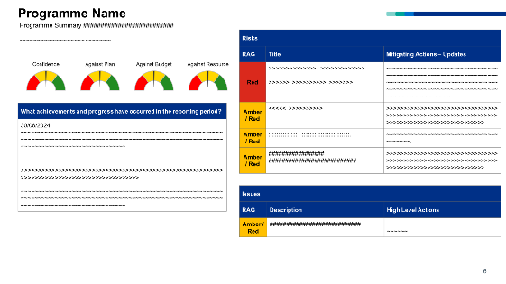
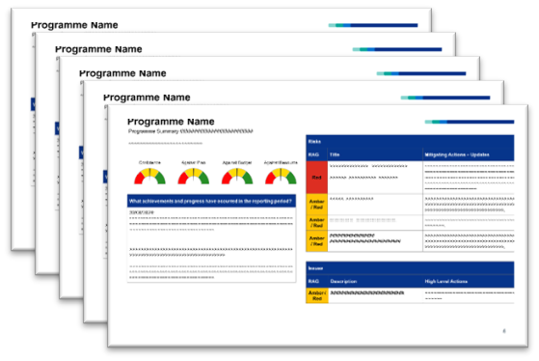
Repeat across all programmes for no additional effort
and across workstreams
Notes:
Once you have the code set up for 1 slide, it’s easy to just loop through it for all the programmes. That proved really popular, so then programmes asked, “ Can we do that at workstream level?” Yes we can! Reusing the code for a different area involved changing path to the data source in 3 places.

Slide 11
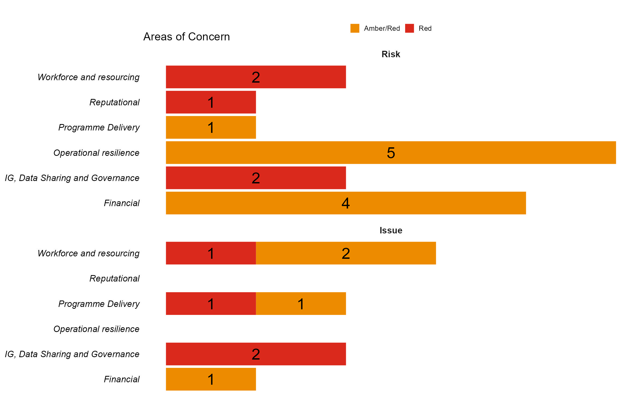
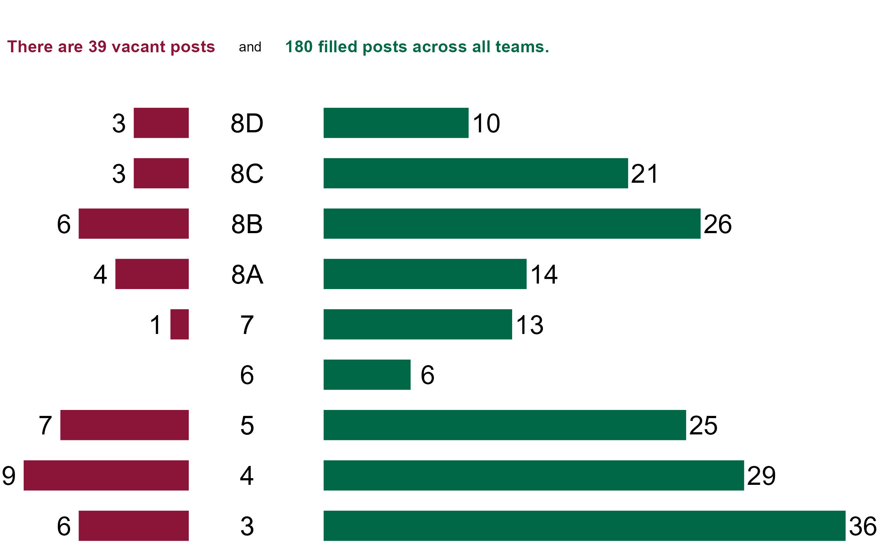
Sample Summary Slide
Programme 1 | Green | 58
doughnut supply | Amber | 49
staff satisfaction | Green | 68
R useage | Green | 82
Programme 2 | Amber | 10
chocolate supply | Red | 52
staff satisfaction | Red | 45
Excel useage | Amber | 43
Programme 3 | Amber | 77
useful reports | Green | 75
Programme 4 | Green | 56
time freed up by automation | Green | 63
additional requests prompted by fabulous reports | Green | 68
R usage | Green | 90
Notes:
And with the free time that created, we could turn our attention to creating other new reports and summaries.

Slide 12
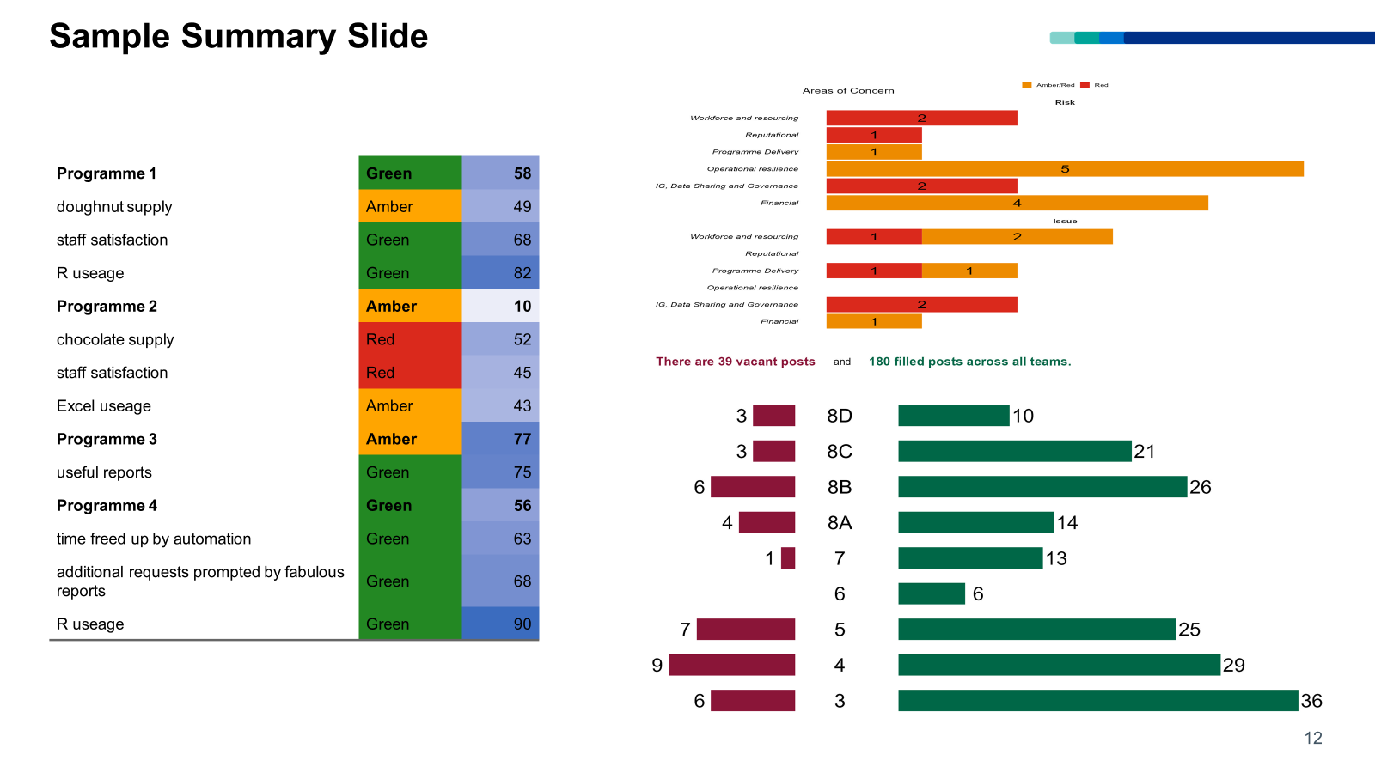
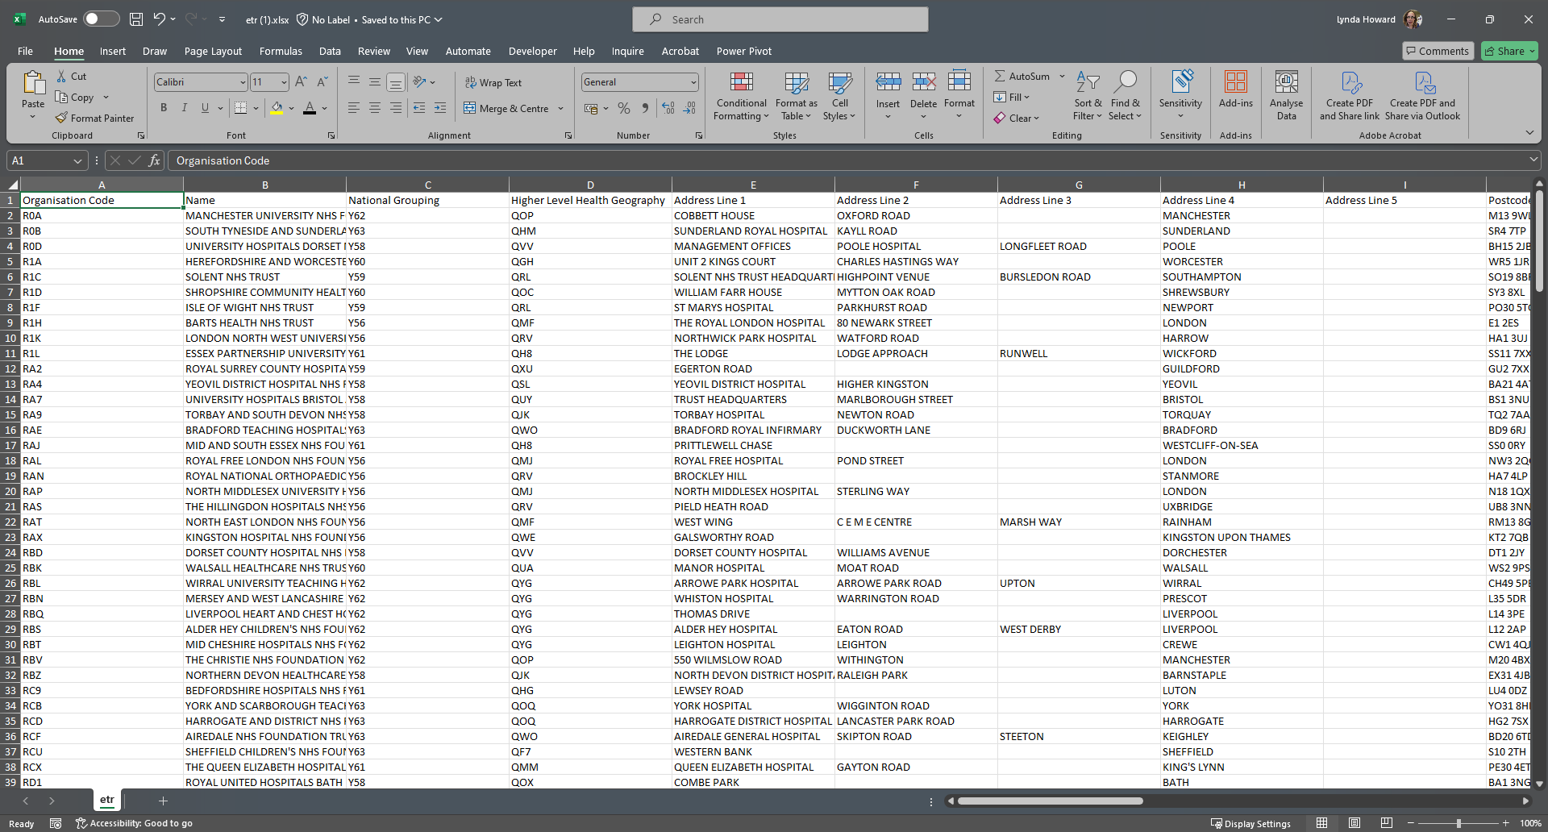
Notes:
So now you can easily produce reports. Fantastic! Now you need to share them, but you have a large Excel file of email addresses. And because these are parameterised reports, they each need a separate email, and we need to be very careful to send the right report to each group of email addresses so we’re not sharing confidential data.
This was the situation in the Estates team, who needed to email reports to all the NHS trusts in England. It was taking several days to manually put together and send out the emails. But it doesn’t have to be that way! R has got your back.

Slide 13
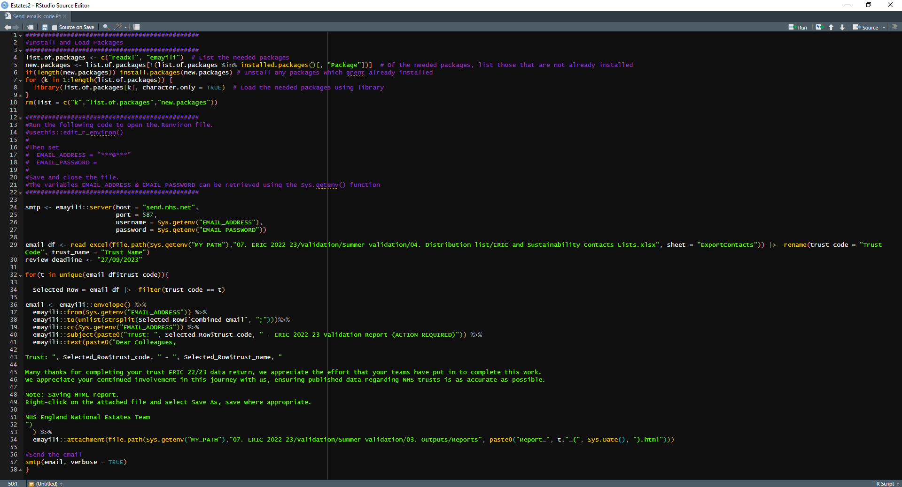
Notes:
I’m including the code here, in its entirety, just so you can see that the whole thing is only 58 rows. With this combination of the {emayili} package and an SMTP enabled email address it took under half an hour to send all the emails.

Slide 14

This presentation on my GitHub & source code for the summary slide & sending emails. LynHUK/DEPOfunctions: DEPO Report Production Functions (github.com) – the package of functions used in Programme Reports.
So where can I find out more?

